Slide 1



Balancing Innovation and Ethics
How Responsible AI is Transforming Enrollment Strategy and Net Revenue Optimization
January 31, 2024

Slide 2

Agenda
Welcome and Introductions
Discussion on Responsible AI
Audience Q&A
Closing and Announcements

Slide 3
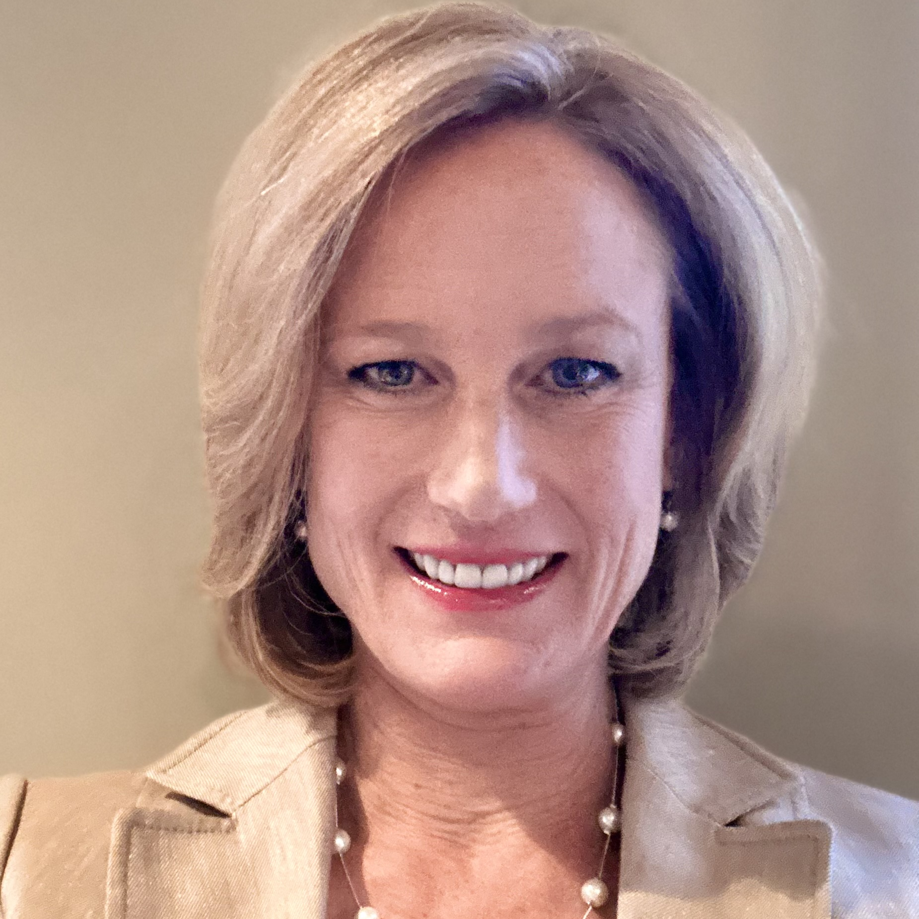
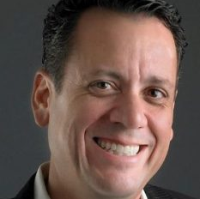
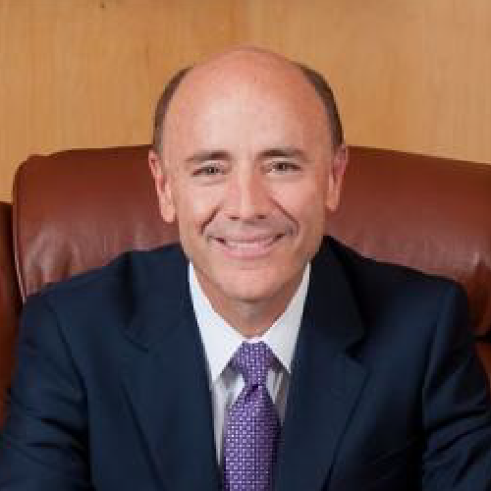



Meet Our Presenters
Sarah Coen
Andy Hannah
Carlos Campo, Ph.D.
Chief Growth Officer
President, Othot
President
Chair, Advisory Board for Responsible Data Science

Slide 4
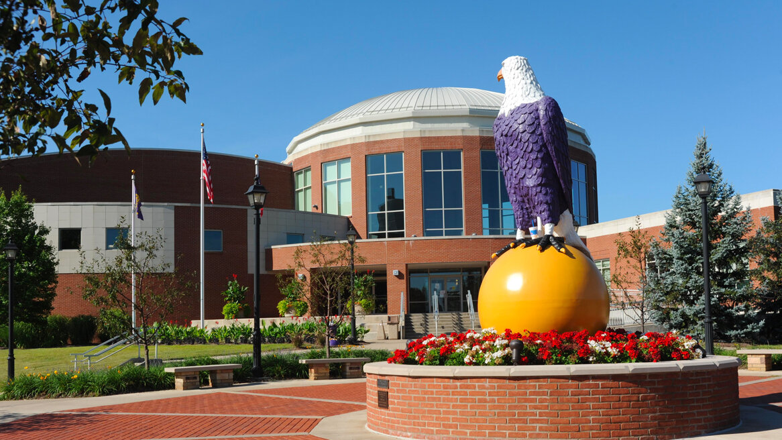

Private, religiously-affiliated university in Ashland, Ohio
Founded in 1878
7,500 undergraduate and graduate students
65+ majors
13:1 student-to-faculty ratio

Slide 5
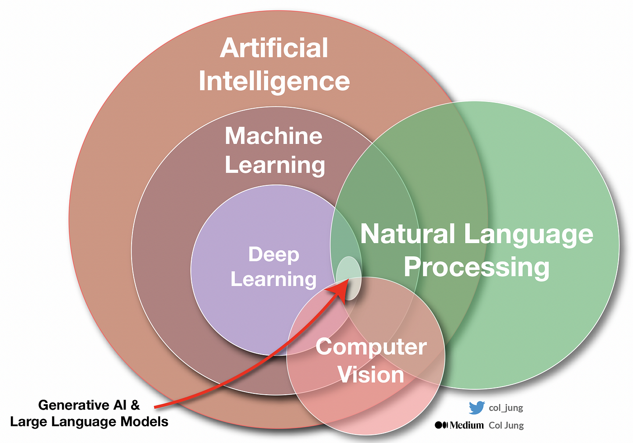
A Glance At:
Defining AI and Related Technologies

Slide 6
Data science’s true spirit is to provide insight about the world around us while centering ethical and responsible services, outcomes, and technologies.”
A Glance At:
Responsible Data Science – the Pipeline to AI
- Data Science Ethos Project (Academic Data Science Alliance)
Responsible Data Science at Pitt:
Empower responsible, use-driven data science across the breadth of the university to solve societal challenges

Slide 7

Discussion

Slide 8

Q&A

Slide 9

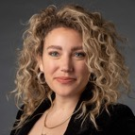

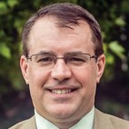
Dan – please have LK design this as a full slide ad to promote our presence at NAICU. No other announcement needed.
Visit Us at NAICU!
Come visit Liaison’s own George Wolf and Hayley Wolf at the NAICU Conference during exhibit hours. See you there!

Slide 10
Connect with us!
Sarah Coen
Liaison
scoen@liaisonedu.com
Dr. Carlos Campo
Ashland University
president@ashland.edu
Andy Hannah
Liaison
ahannah@liaisonedu.com

Slide 11
Have questions?
Let's continue the conversation!
THANK
YOU

